Slide 1
Godoekchon
Manguonchon (H2)
Amsa
Choichon (H1)
Guui
Yangchechon H4
Jamsil
yangchechon
Tachon 5
Seongnechon
Kamichon (H3)
Ttukdo
Jungnangchon 4
Jungkechon 3
Bogwang
Norangjin (H)
Yeongdungpo
Hongchechon
Anyangchon 5
Gayang

Slide 2
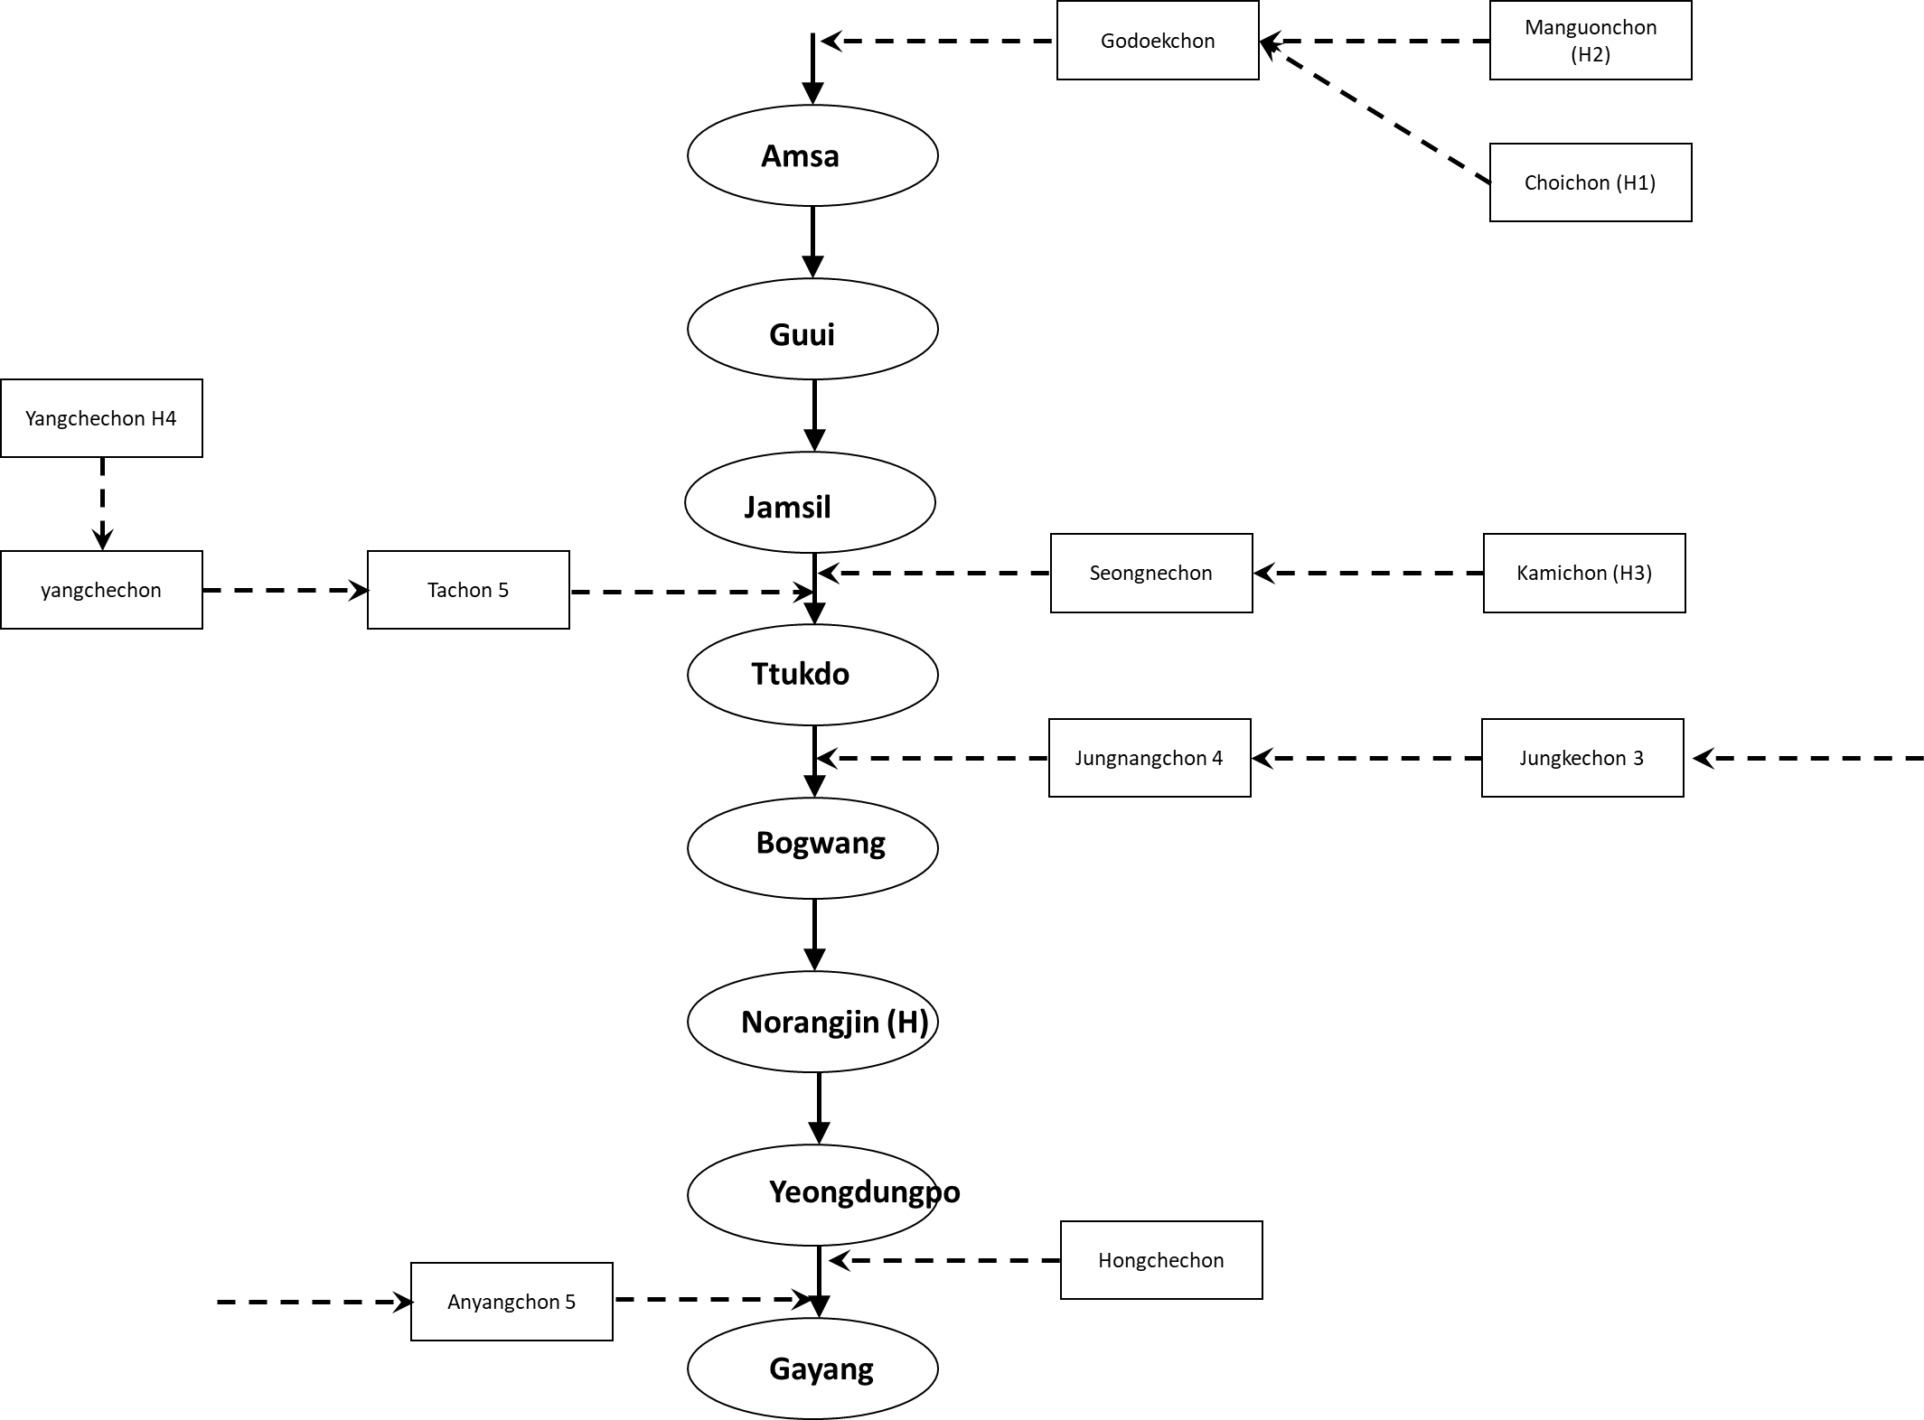

Slide 3
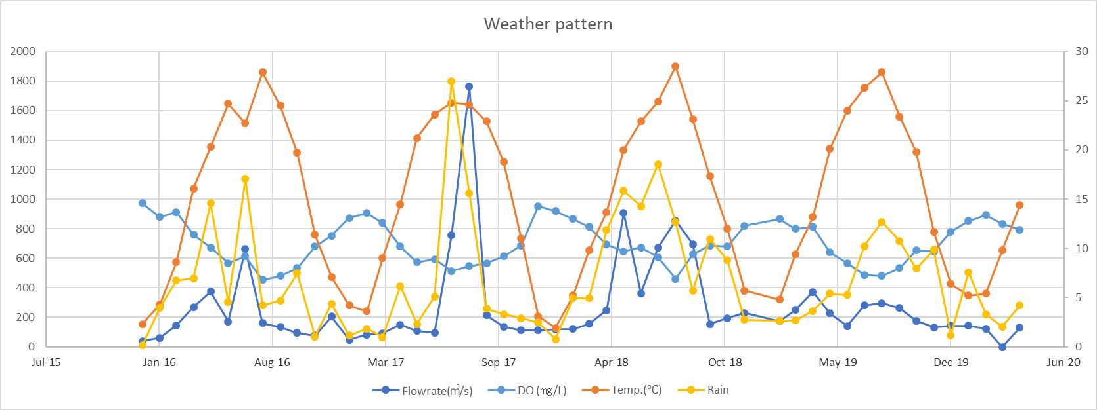

Slide 4
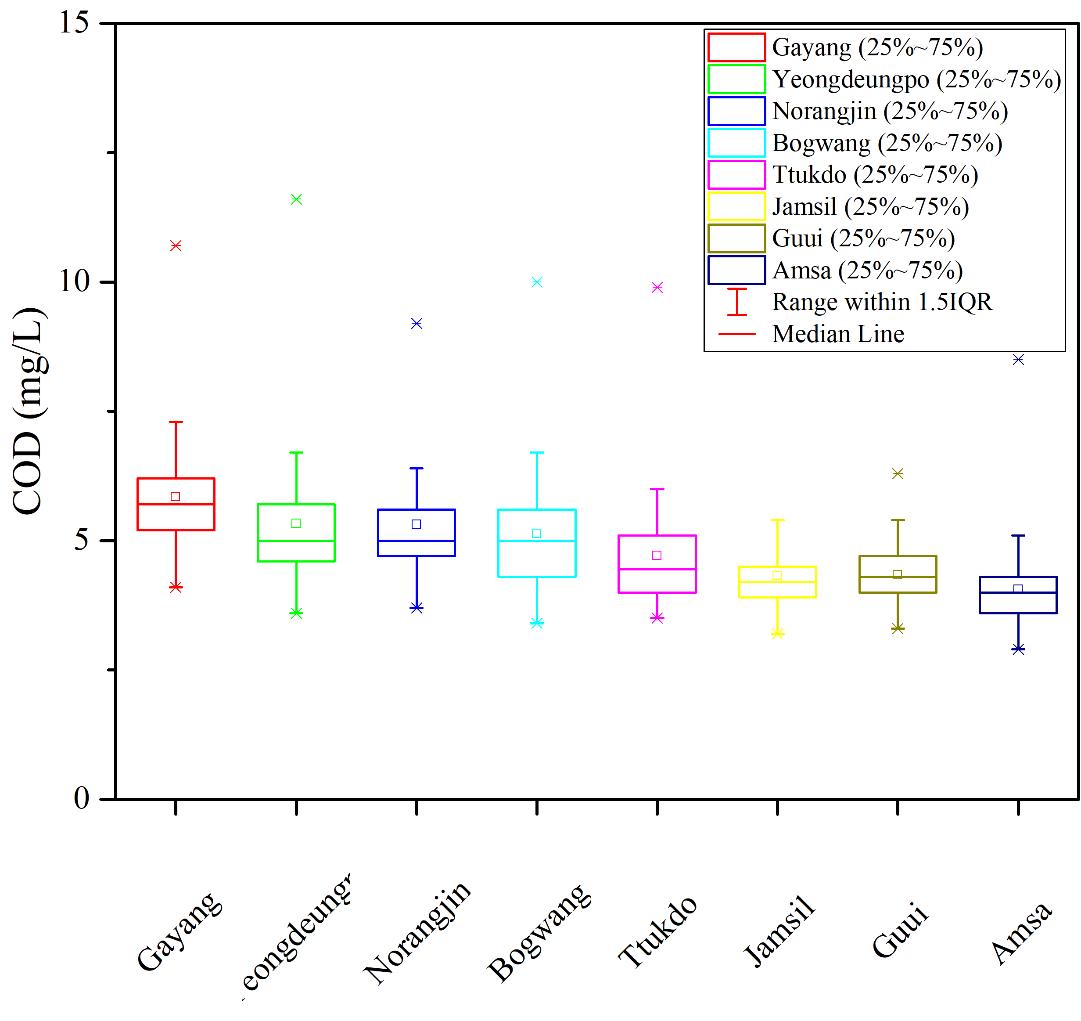
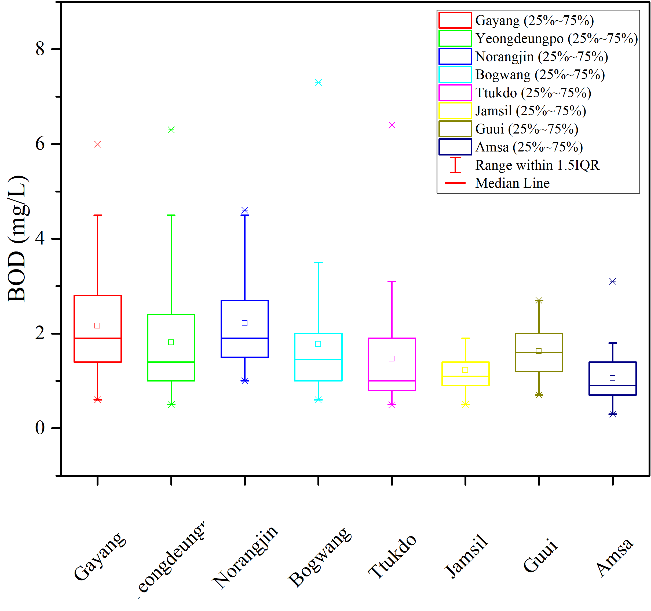
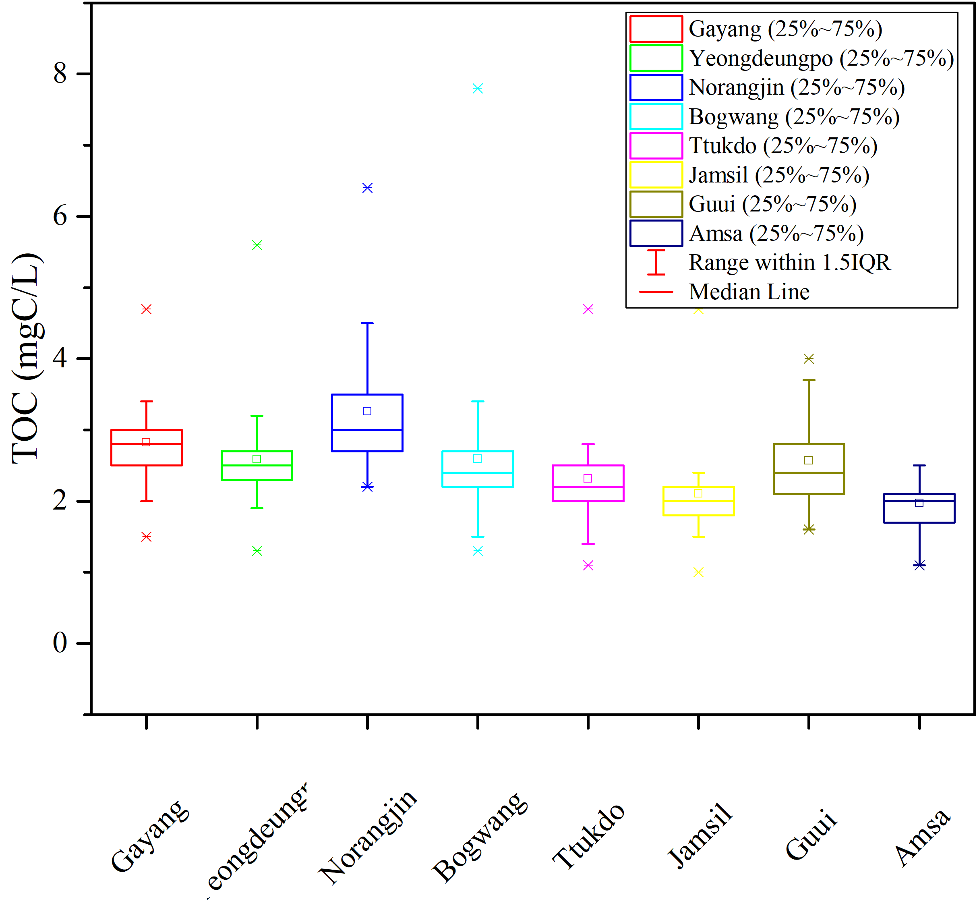
Spatial variation

Slide 5
Increase pollution with the main stream from Amsa (inlet) to Gayang (outlet). Sone notable difference among the water quality station of COD, BOD and TOC suggests the chemical composition of the water river change.
BOD is more variable and about half of COD -> pollutants are quite labile. BOD significantly increase in Norangjin, slightly decrease in Yeongdungpo, then increase in Gayang. Noranjin is the famous seafood market in Seoul while no surface discharge from Norangjin to Yeodungpo (water dilution).
TOC represents organic carbon content (C) in the water, Norangjin has notable higher content of organic carbon than other stations.
…

Slide 6
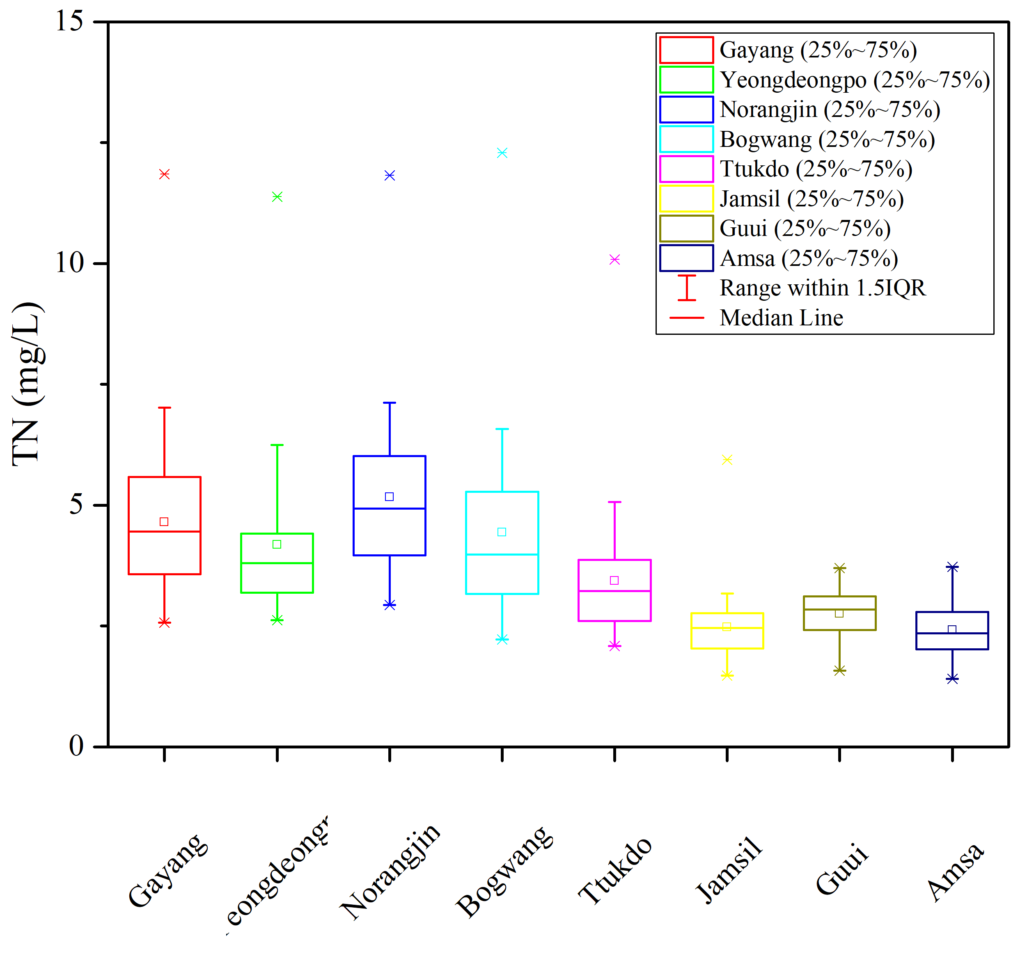
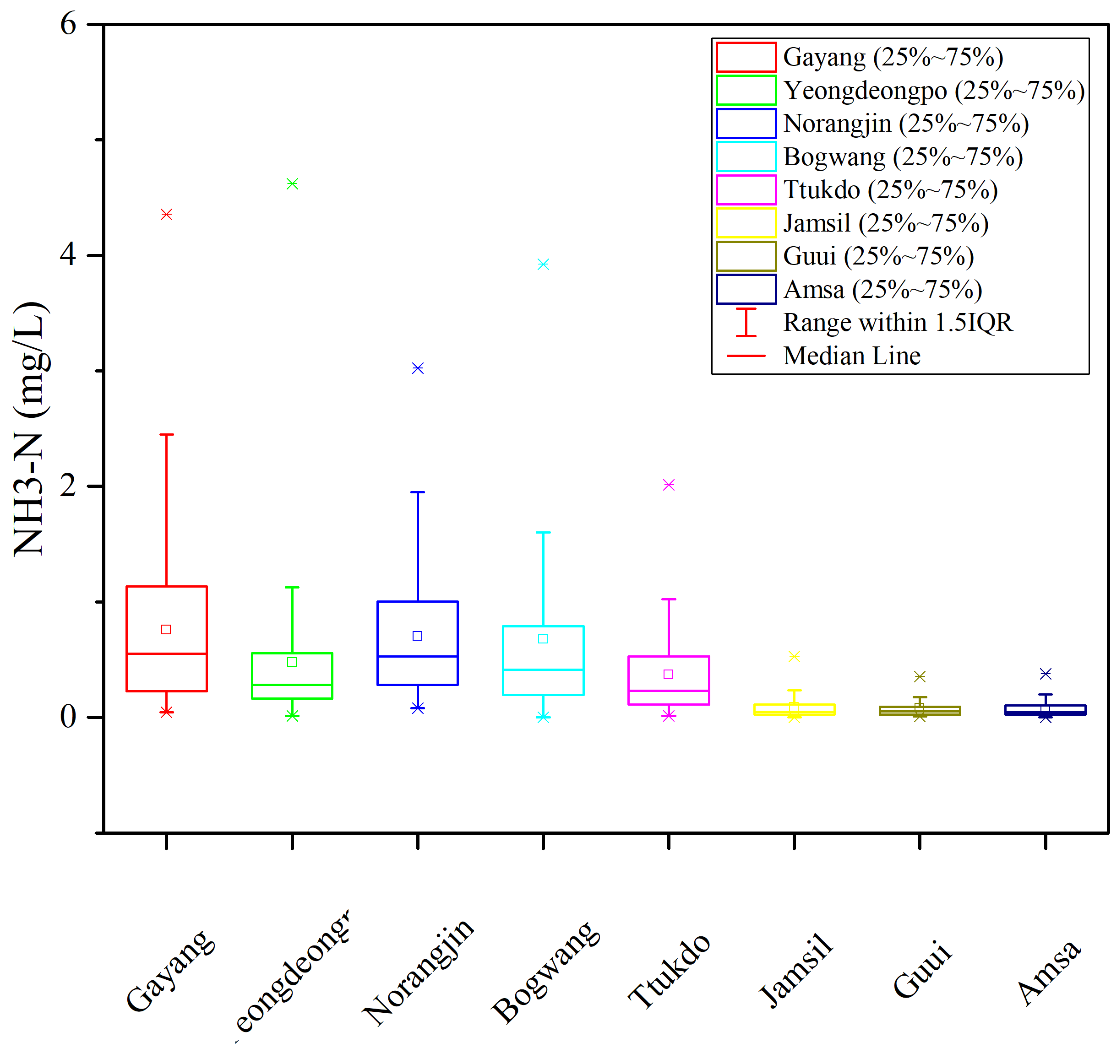
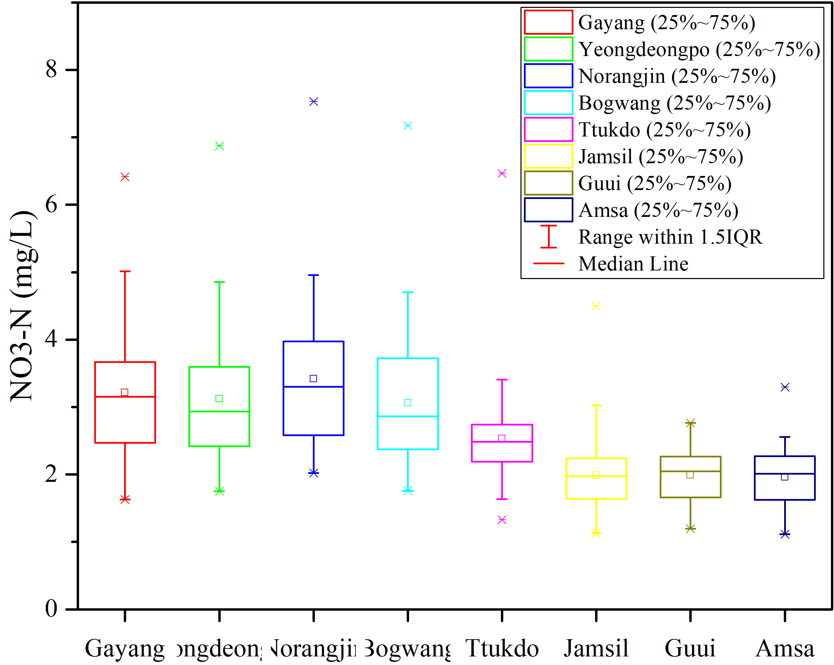
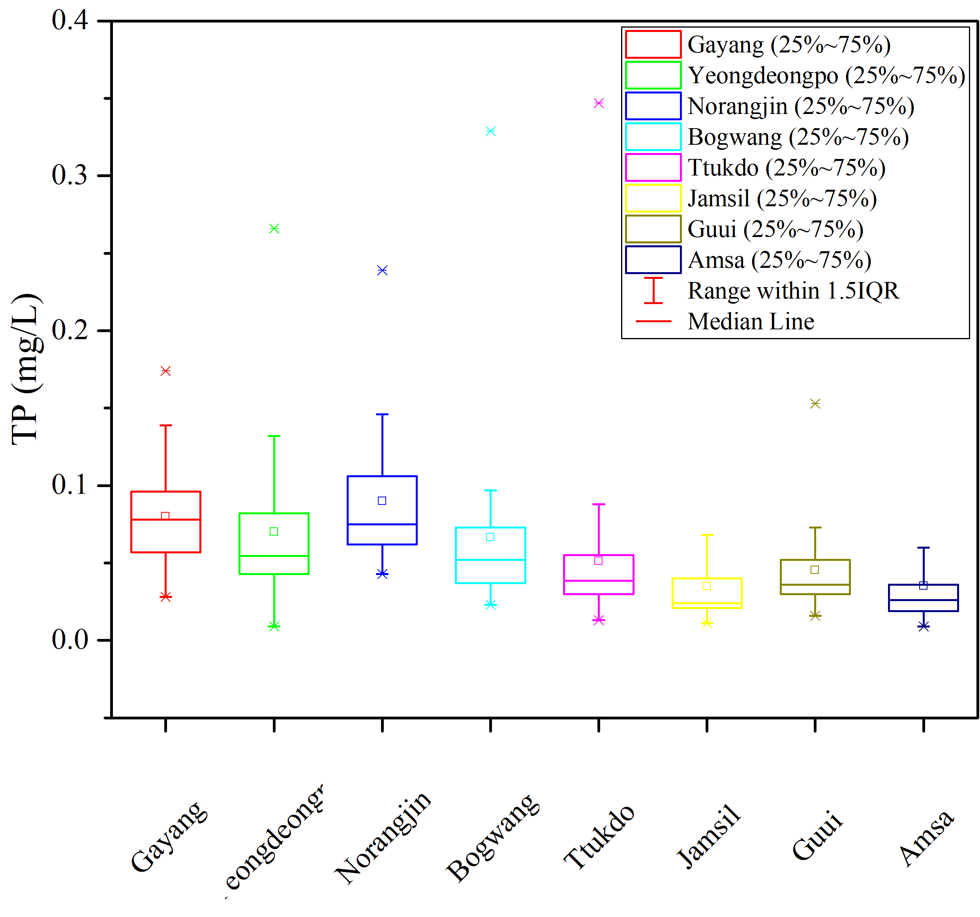
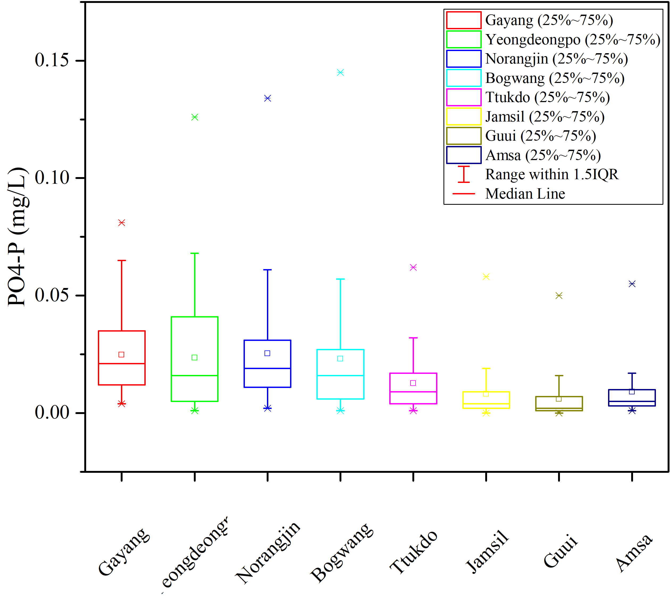

Slide 7
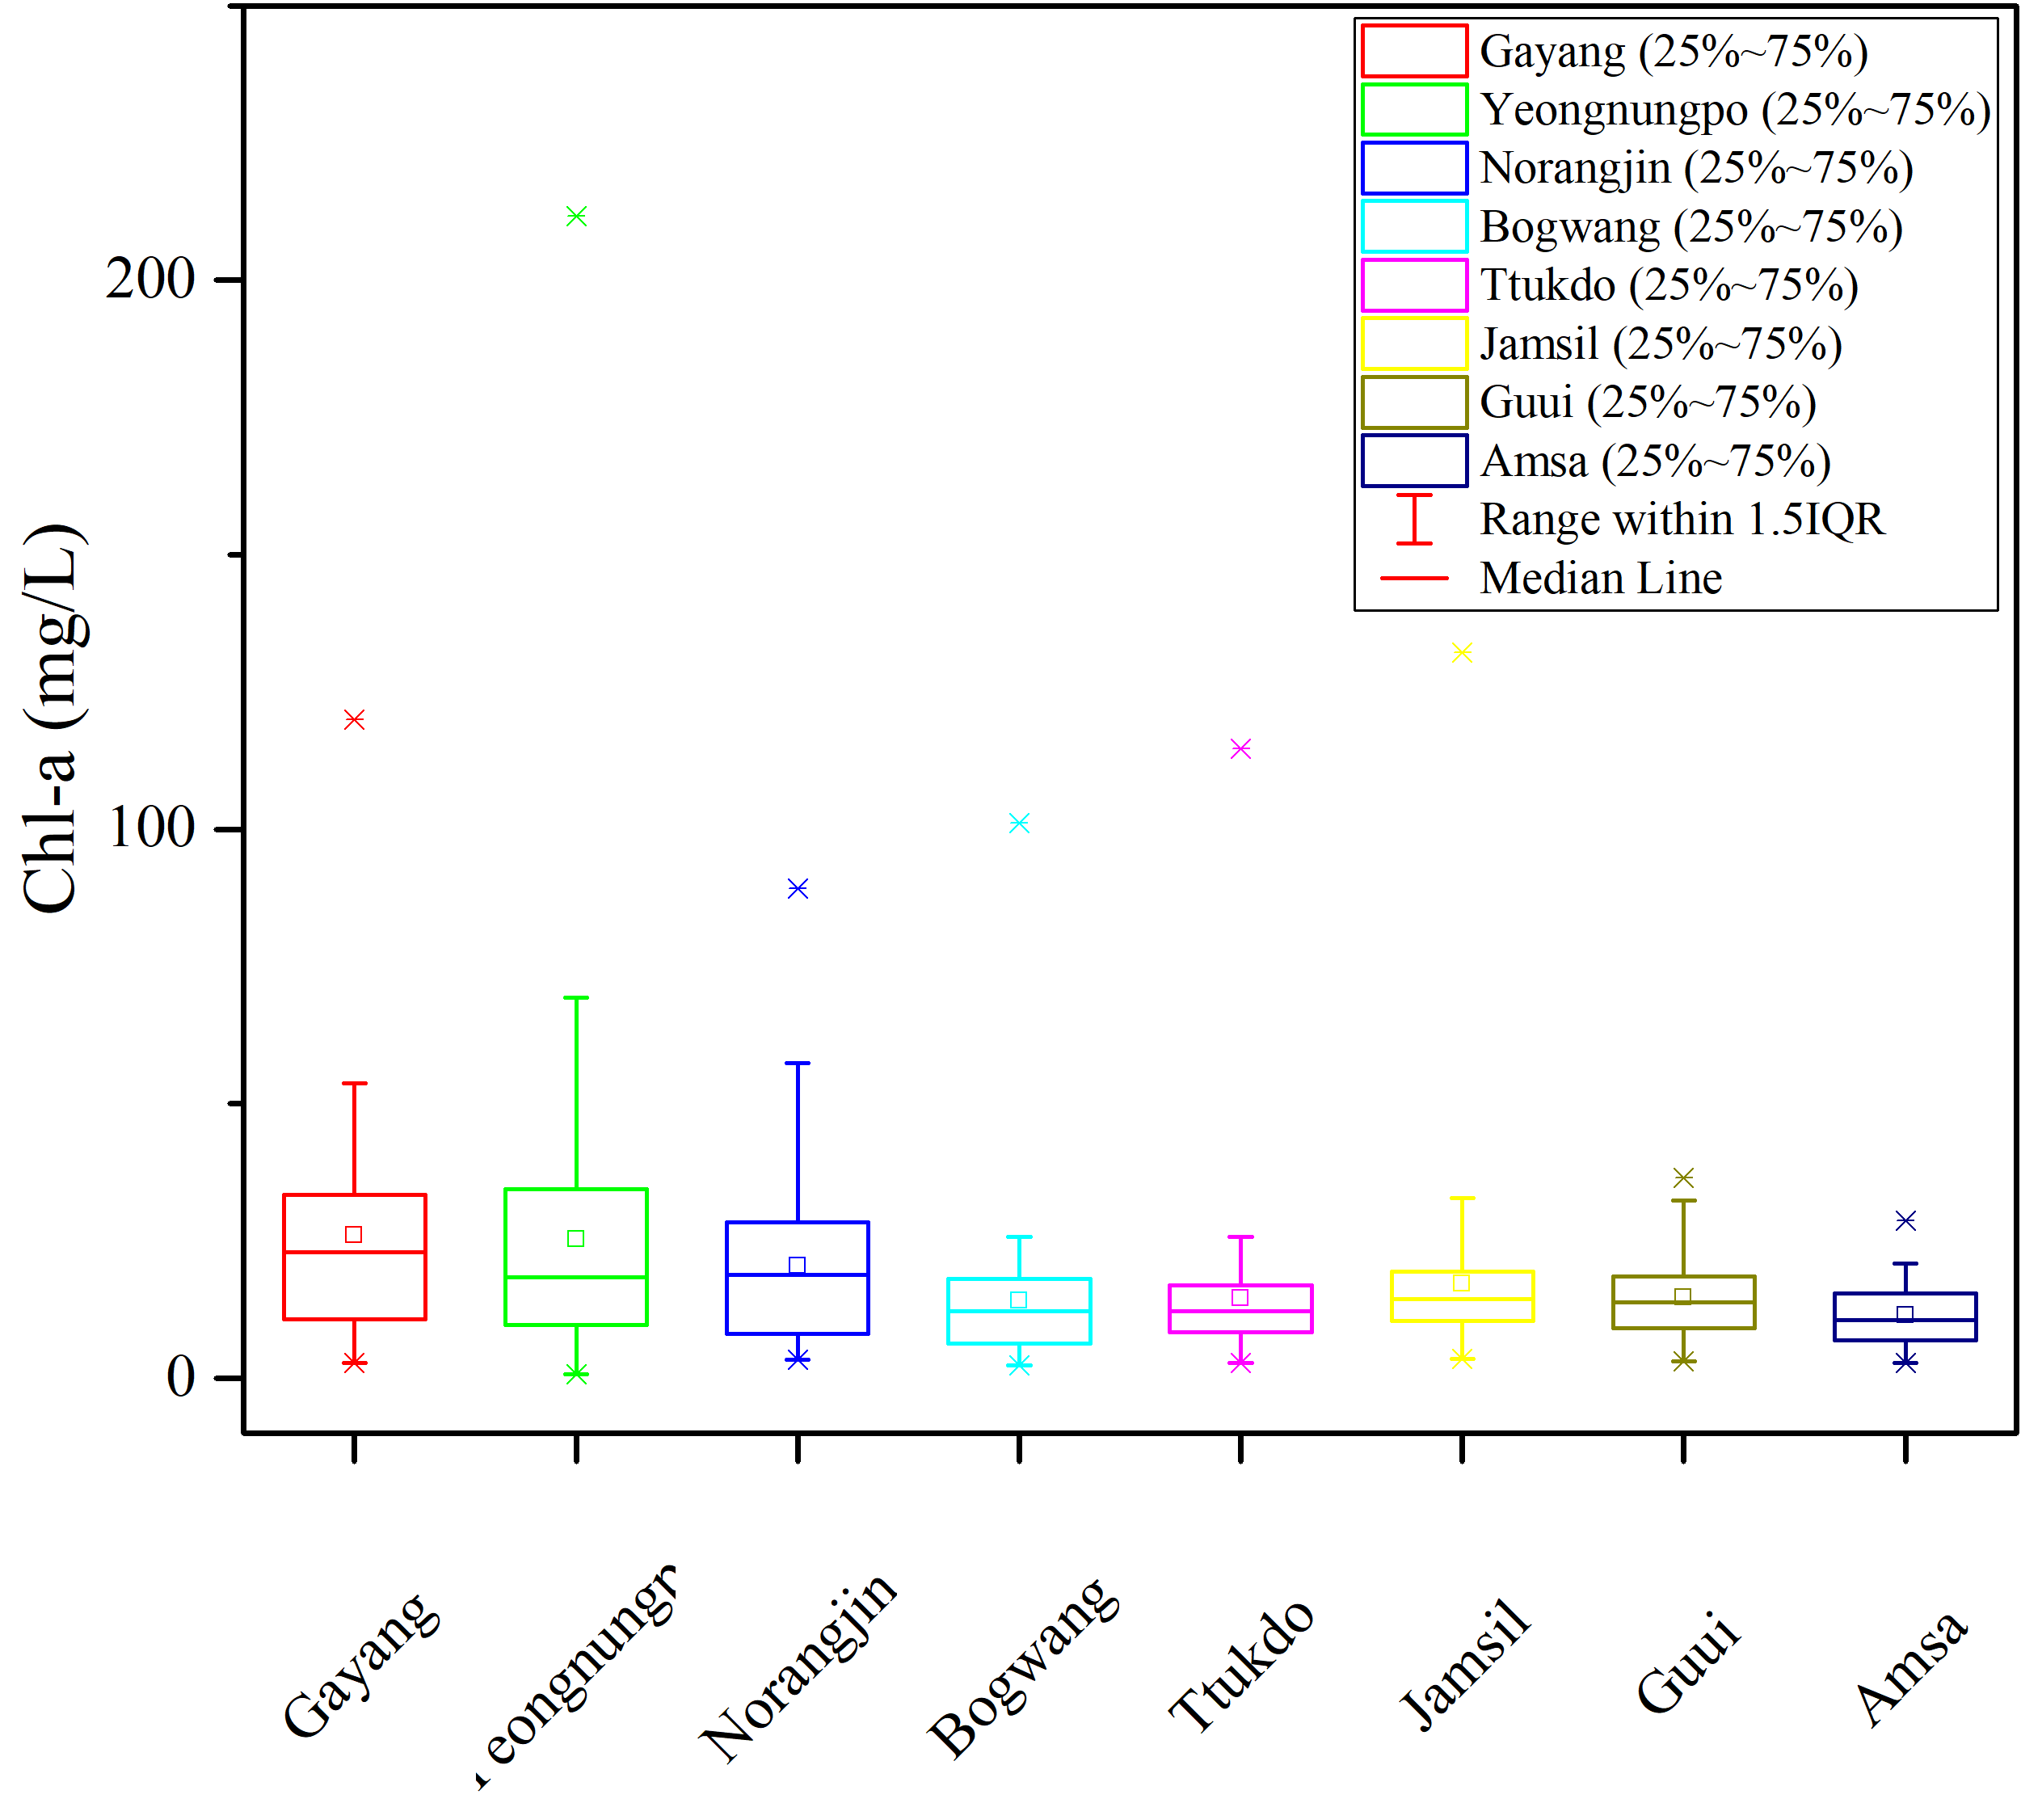
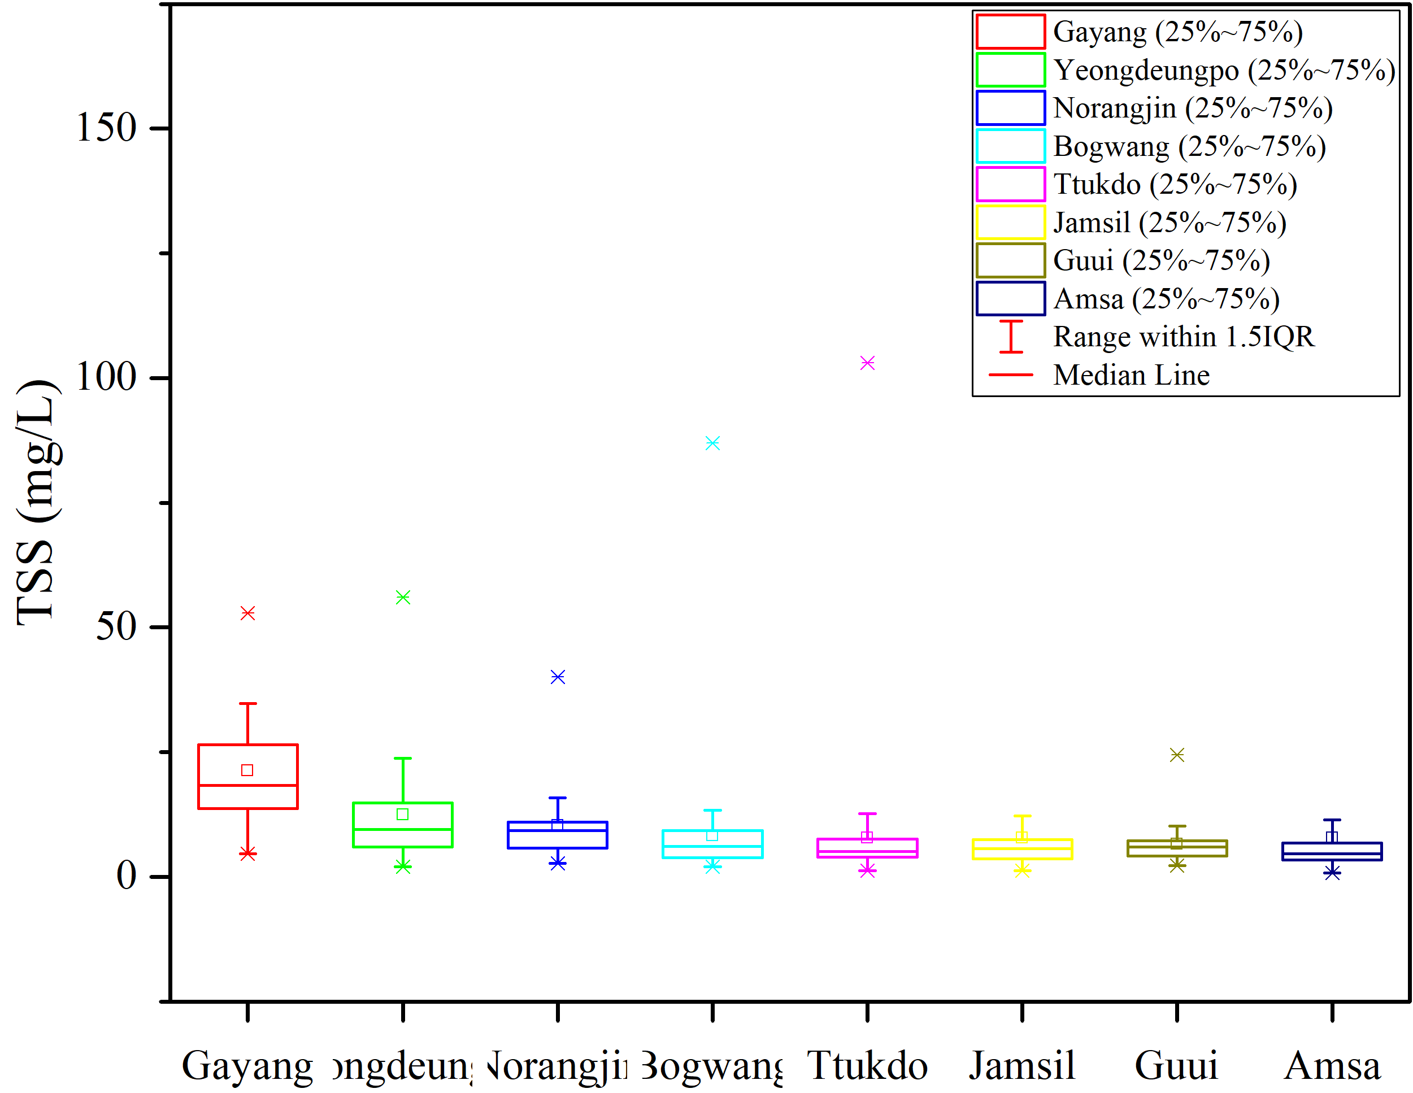

Slide 8
Increase of N, P with water stream. For Nitrogen, three stations near the inlet showed no significant discrepancy (Jamsil, Guui, Amsa) but the N starts to increase and reach peak at Norangjin. The trend is somehow similar to Phosphorus
Compared to NH3, NO3 consists major part of TN. The high DO content suggests the effective nitrification process within the river body. PO4 contribute only minor fraction in TP.
We should say some conclusion about the water quality in the river by some water index; whether water is eutrophication, oligotrophication??, algal bloom?

Slide 9
Seasonal Variation
 | Gayang |  | Yeongdeungpo |  | Norangjin |  | Bogwang |  | Ttukdo |  | Jamsil |  | Guui |  | Amsa
Parameters | Dry Cold | Hot Wet | Dry Cold | Hot Wet | Dry Cold | Hot Wet | Dry Cold | Hot Wet | Dry Cold | Hot Wet | Dry Cold | Hot Wet | Dry Cold | Hot Wet | Dry Cold | Hot Wet
COD | 5.98 | 5.7 | 5.55 | 5.08 | 5.45 | 5.17 | 5.46 | 4.78 | 4.89 | 4.5 | 4.29 | 4.36 | 4.19 | 4.5 | 3.94 | 4.18
p-value | 0.41 |  | 0.22 |  | 0.39 |  | 0.05 |  | 0.23 |  | 0.81 |  | <0.05 |  | 0.27
BOD | 2.37 | 1.94 | 2.17 | 1.34 | 2.38 | 2.03 | 2.28 | 1.23 | 1.9 | 1 | 1.4 | 1.03 | 1.61 | 1.63 | 1.2 | 0.9
p-value | 0.16 |  | 0.02 |  | 0.19 |  | 0.01 |  | 0.01 |  | 0.09 |  | 0.81 |  | 0.06
TOC | 2.96 | 2.68 | 2.75 | 2.41 | 3.37 | 3.13 | 2.81 | 2.35 | 2.36 | 2.27 | 2.12 | 2.1 | 2.49 | 2.66 | 1.87 | 2.08
p-value | 0.06 |  | 0.08 |  | 0.36 |  | 0.09 |  | 0.58 |  | 0.89 |  | 0.3 |  | 0.18
TN | 5.63 | 3.55 | 4.95 | 3.35 | 6.11 | 4.11 | 5.25 | 3.56 | 3.97 | 2.87 | 2.79 | 2.13 | 3.03 | 2.46 | 2.69 | 2.11
p-value | 0.01 |  | 0.01 |  | 0.01 |  | 0.01 |  | 0.01 |  | 0.01 |  | 0.01 |  | 0.01
NH3 | 1.07 | 0.41 | 0.69 | 0.25 | 0.98 | 0.39 | 0.98 | 0.35 | 0.56 | 0.16 | 0.13 | 0.05 | 0.12 | 0.04 | 0.08 | 0.06
p-value | 0.01 |  | 0.02 |  | 0.01 |  | 0.01 |  | 0.01 |  | 0.01 |  | 0.01 |  | 0.24
NO3 | 3.77 | 2.59 | 3.6 | 2.6 | 4 | 2.76 | 3.33 | 2.77 | 2.71 | 2.33 | 2.17 | 1.77 | 2.21 | 1.76 | 2.14 | 1.76
p-value | 0.01 |  | 0.01 |  | 0.01 |  | <0.05 |  | 0.07 |  | 0.01 |  | 0.01 |  | 0.01
TP | 0.07 | 0.1 | 0.06 | 0.08 | 0.08 | 0.1 | 0.06 | 0.07 | 0.05 | 0.06 | 0.03 | 0.04 | 0.04 | 0.05 | 0.03 | 0.05
p-value | 0.01 |  | 0.03 |  | >0.05 |  | 0.81 |  | 0.44 |  | 0.13 |  | 0.06 |  | 0.12
PO4 | 0.02 | 0.03 | 0.02 | 0.03 | 0.02 | 0.03 | 0.02 | 0.03 | 0.01 | 0.02 | 0 | 0.01 | 0 | 0.01 | 0 | 0.01
p-value | 0.01 |  | 0.03 |  | 0.3 |  | 0.46 |  | 0.02 |  | 0.01 |  | 0.02 |  | 0.02
TSS | 17.53 | 25.42 | 8.76 | 16.4 | 7.14 | 13.84 | 5.85 | 10.92 | 5.65 | 10.01 | 5.76 | 10.13 | 5.21 | 8.12 | 4.93 | 11.05
p-value | 0.01 |  | 0.02 |  | 0.01 |  | 0.01 |  | 0.28 |  | 0.27 |  | 0.02 |  | 0.01
Chl-a | 27.76 | 24.46 | 29.08 | 21.43 | 21.12 | 19.68 | 14.23 | 14.21 | 15.74 | 13.4 | 18.19 | 16.26 | 14.31 | 15.32 | 11.19 | 11.74
p-value | 0.55 |  | 0.39 |  | 0.74 |  | 0.99 |  | 0.6 |  | 0.7 |  | 0.63 |  | 0.73

Slide 10
Say some general trend of water with time; whether the water pollution becomes more severe with time by comparing the water quality in the inlet (Amsa) and the outlet (Gayang).
Based the weather patterns, the weather effects could be categorized into two major seasons: Dry cold (November to April) and Hot Wet (May to October). The comparison is conducted by one-way ANOVA
…

Slide 11
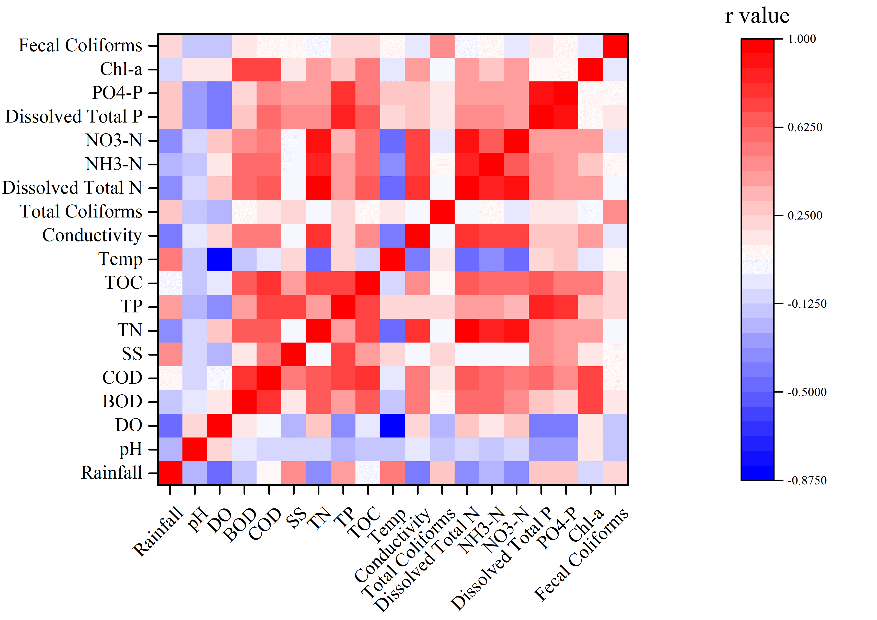
Correlation between different parameters

Slide 12
Machine Learning to predict water quality

